Slide 1
Poketeams
Full Stack Web Application

Slide 2
Problem statement
Terminal applications lack features that users today have come to expect.
Most of the available team builder applications lack the ability to create multiple teams and customise moves.

Slide 3
The solution
Both of the problems explained can be solved by recreating the Poketeams terminal application as a web application.

Slide 4
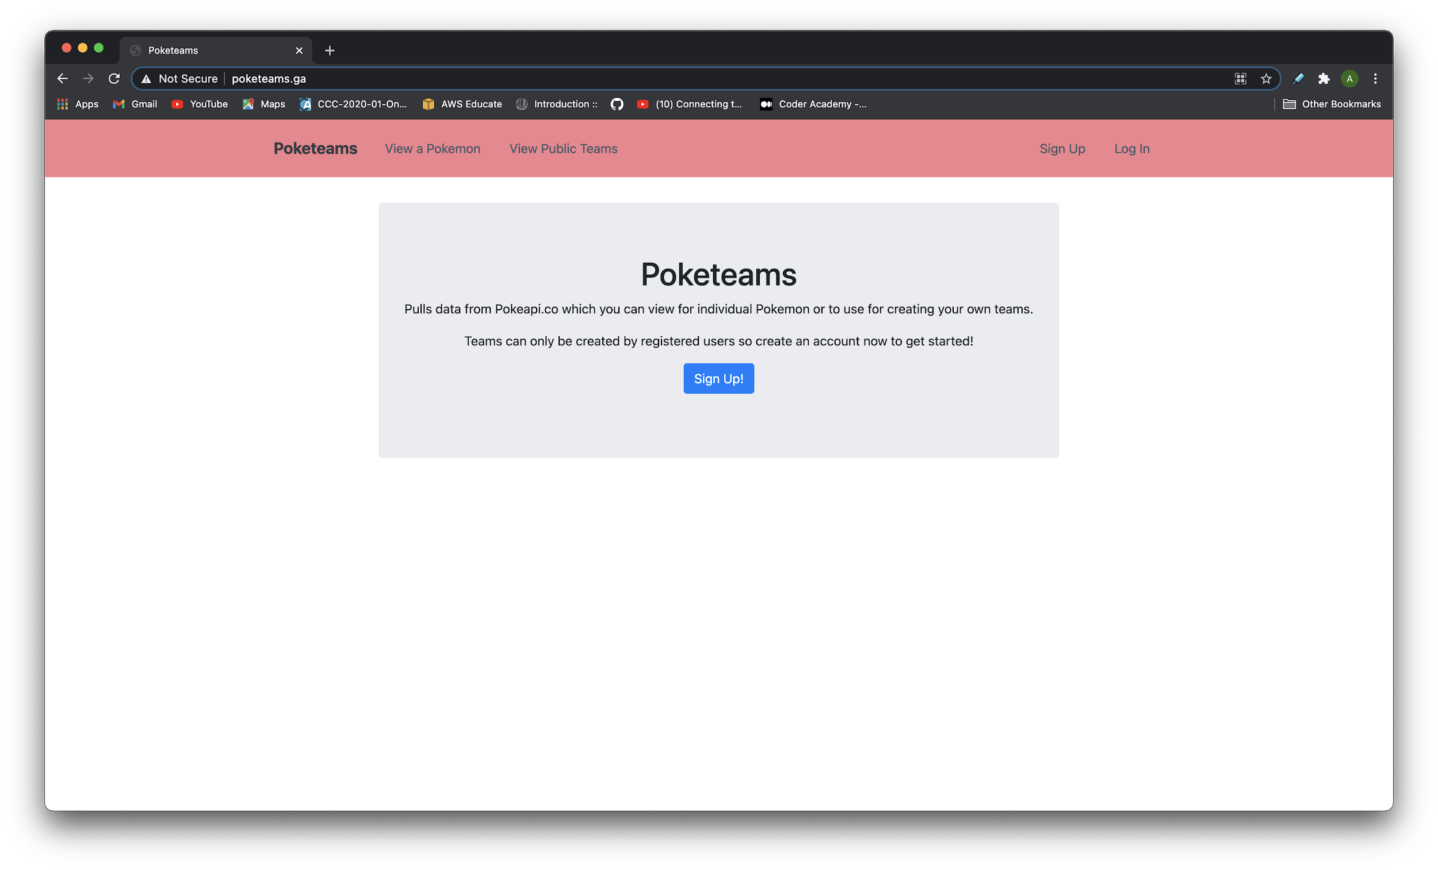
Application Demo
Landing Page
|
View a Pokemon

Slide 5
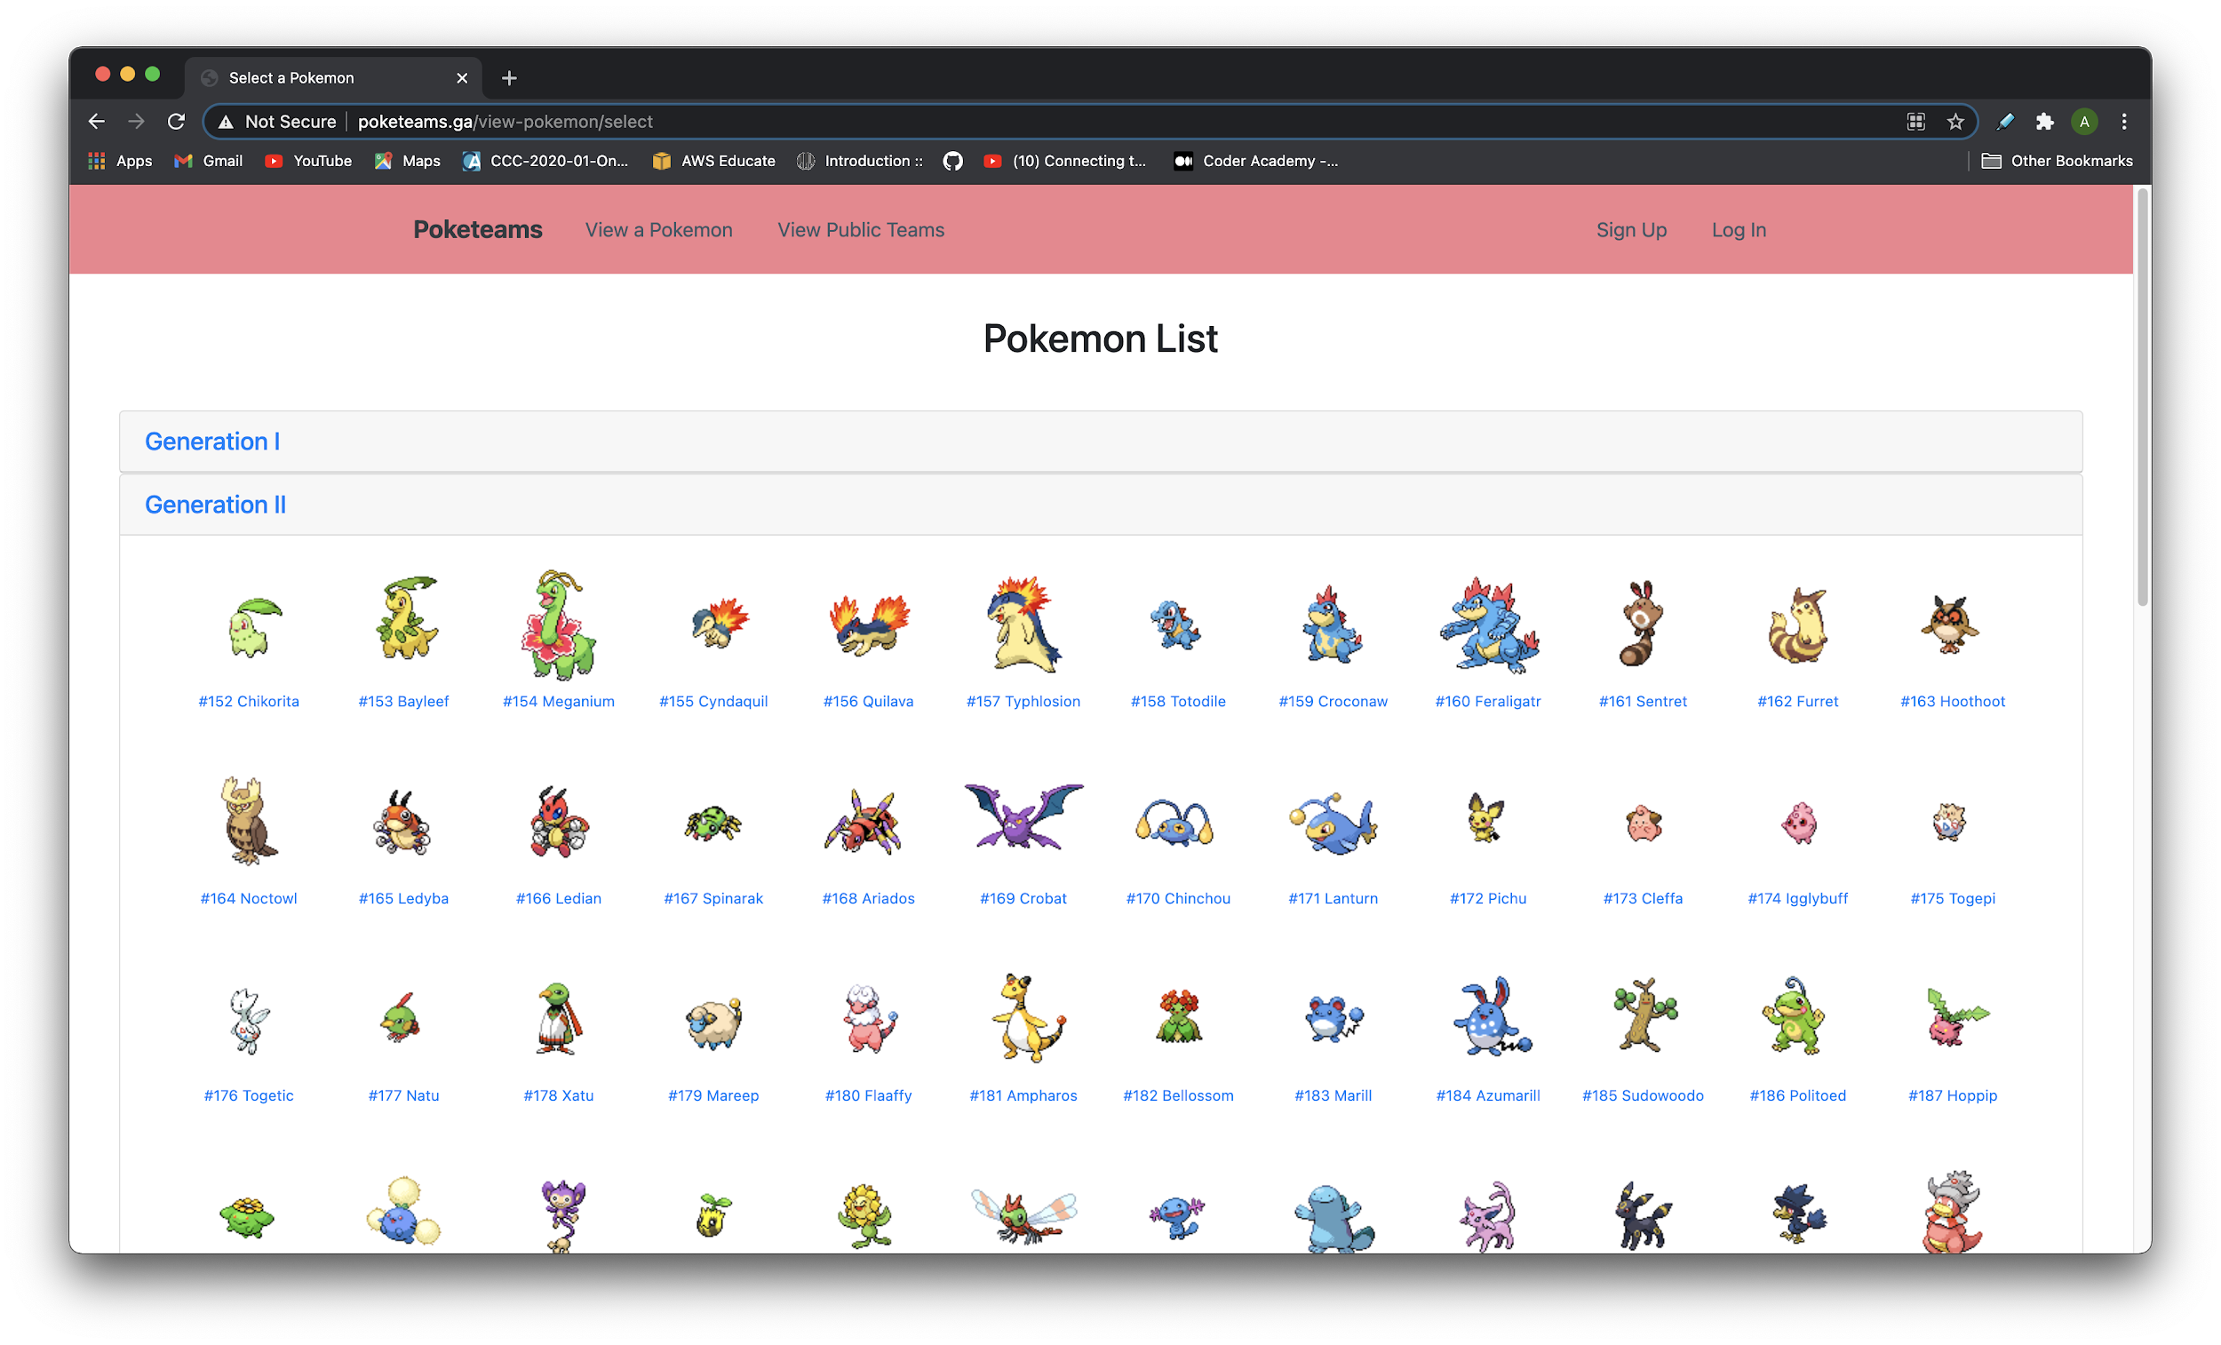
Application Demo
Selecting a Pokemon to view

Slide 6
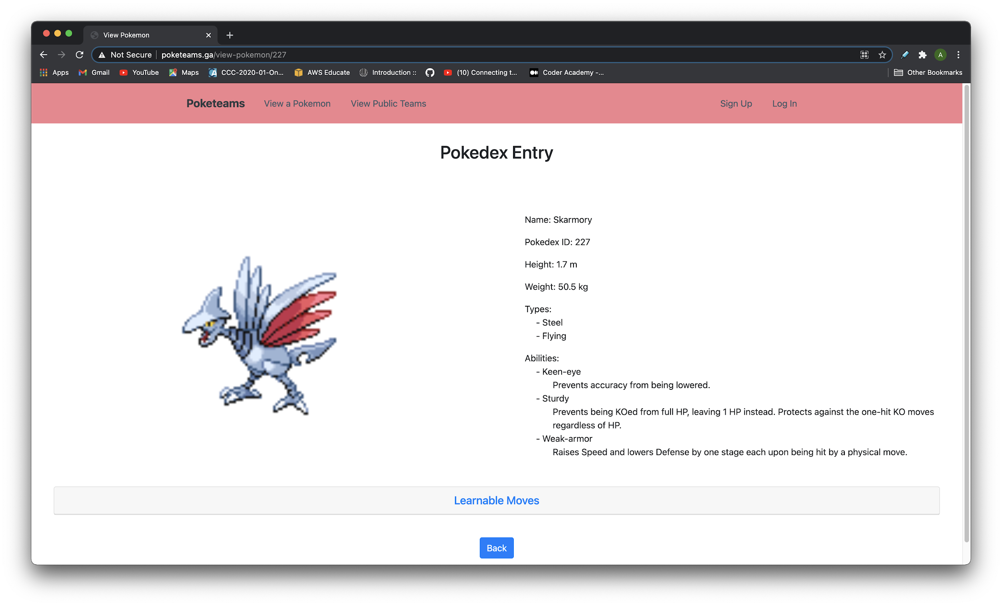
Application Demo
Viewing the pokedex entry

Slide 7
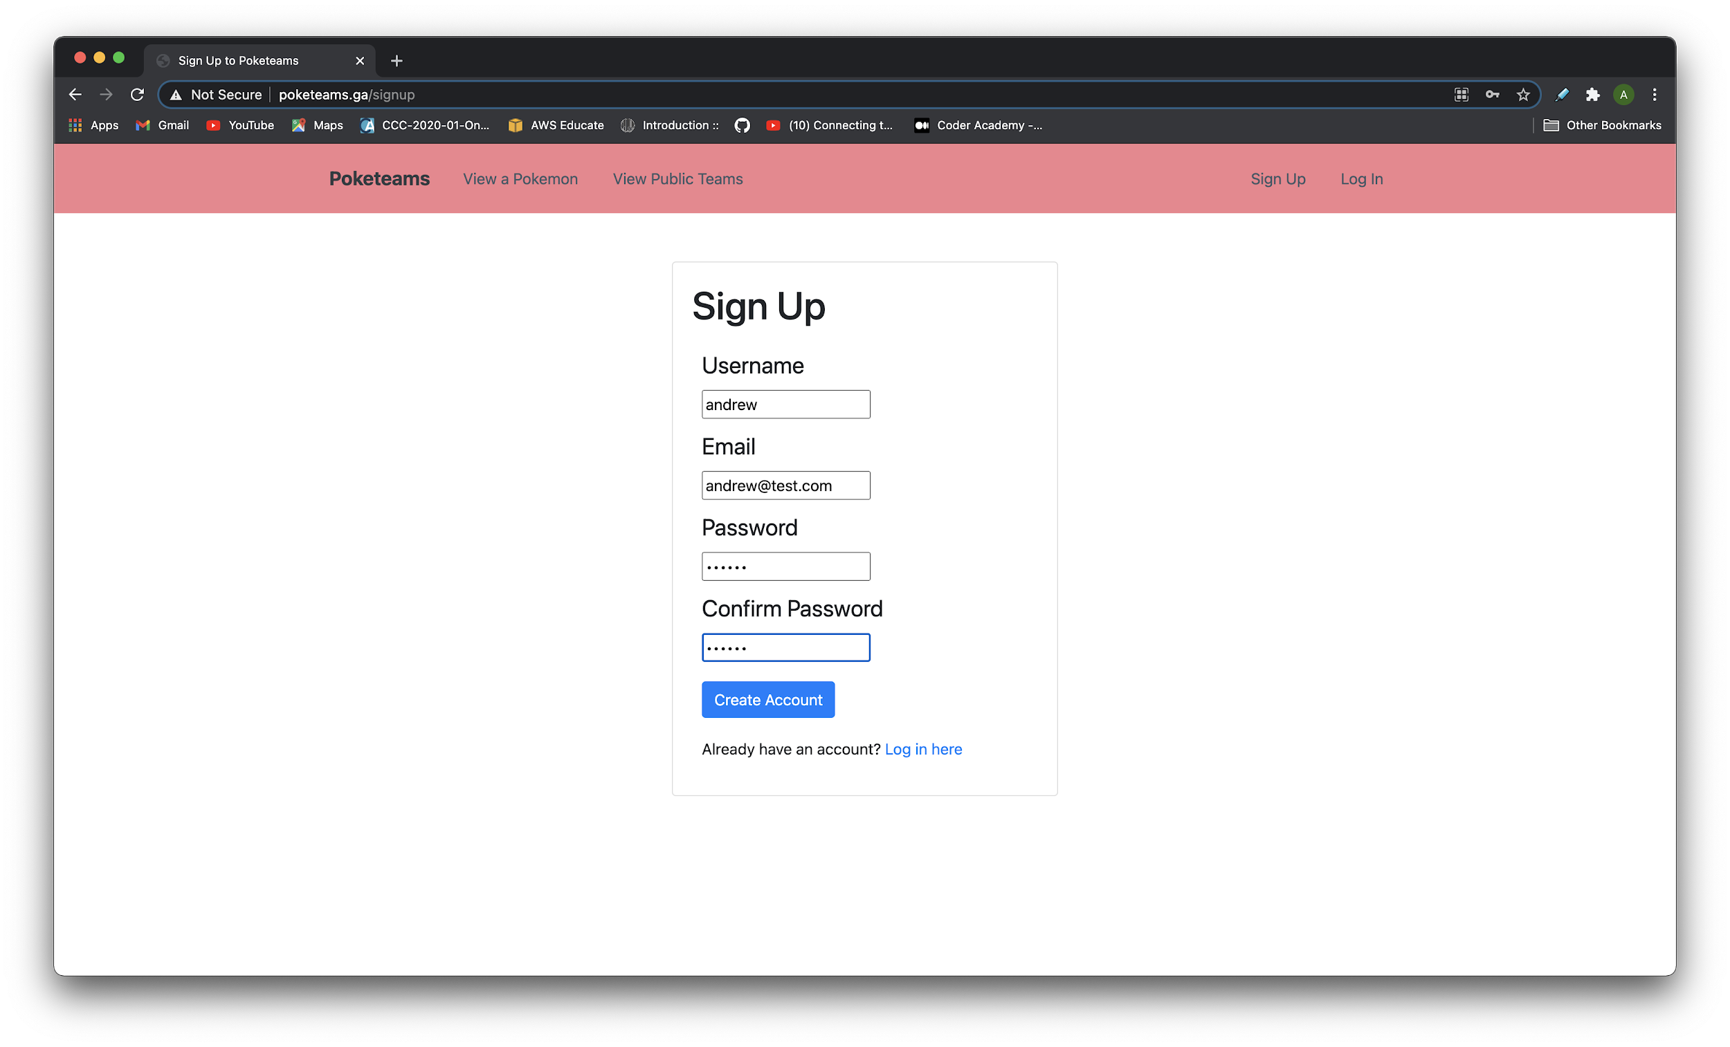
Application Demo
Signing Up

Slide 8
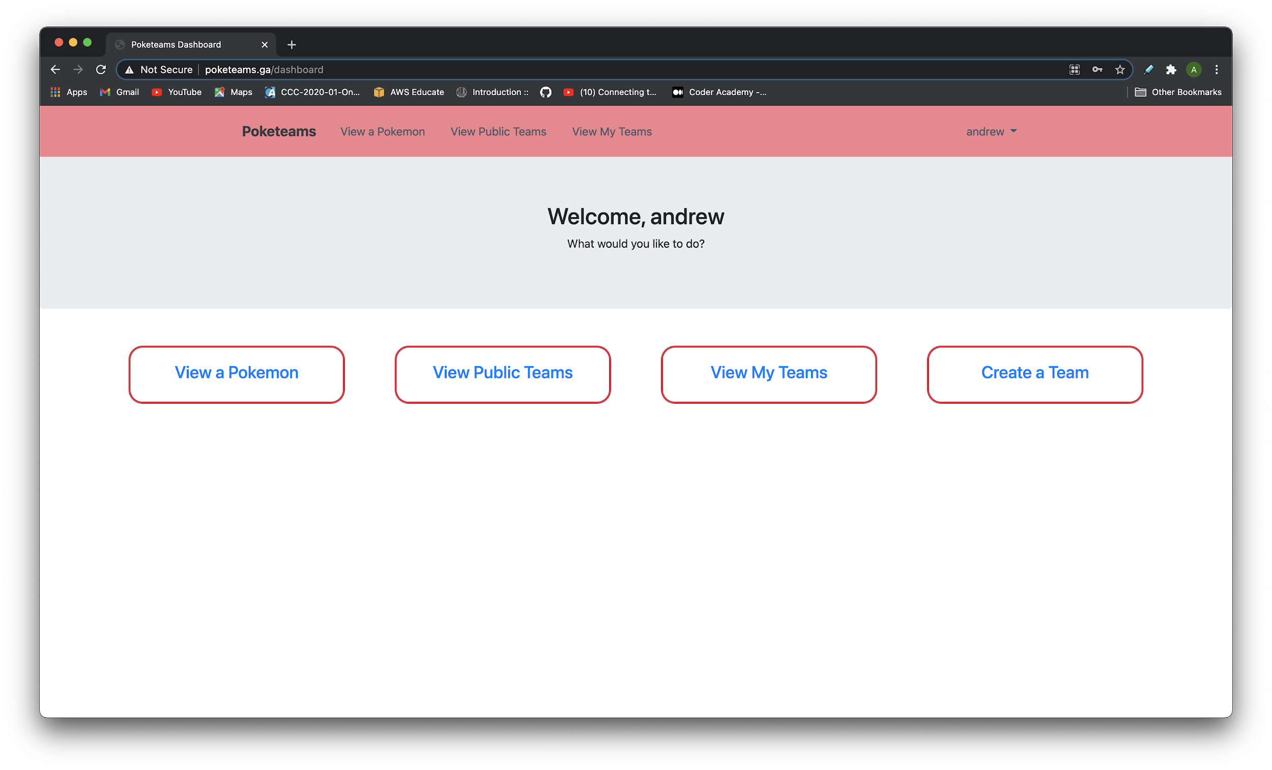
Application Demo
Dashboard Page
|
View my teams

Slide 9
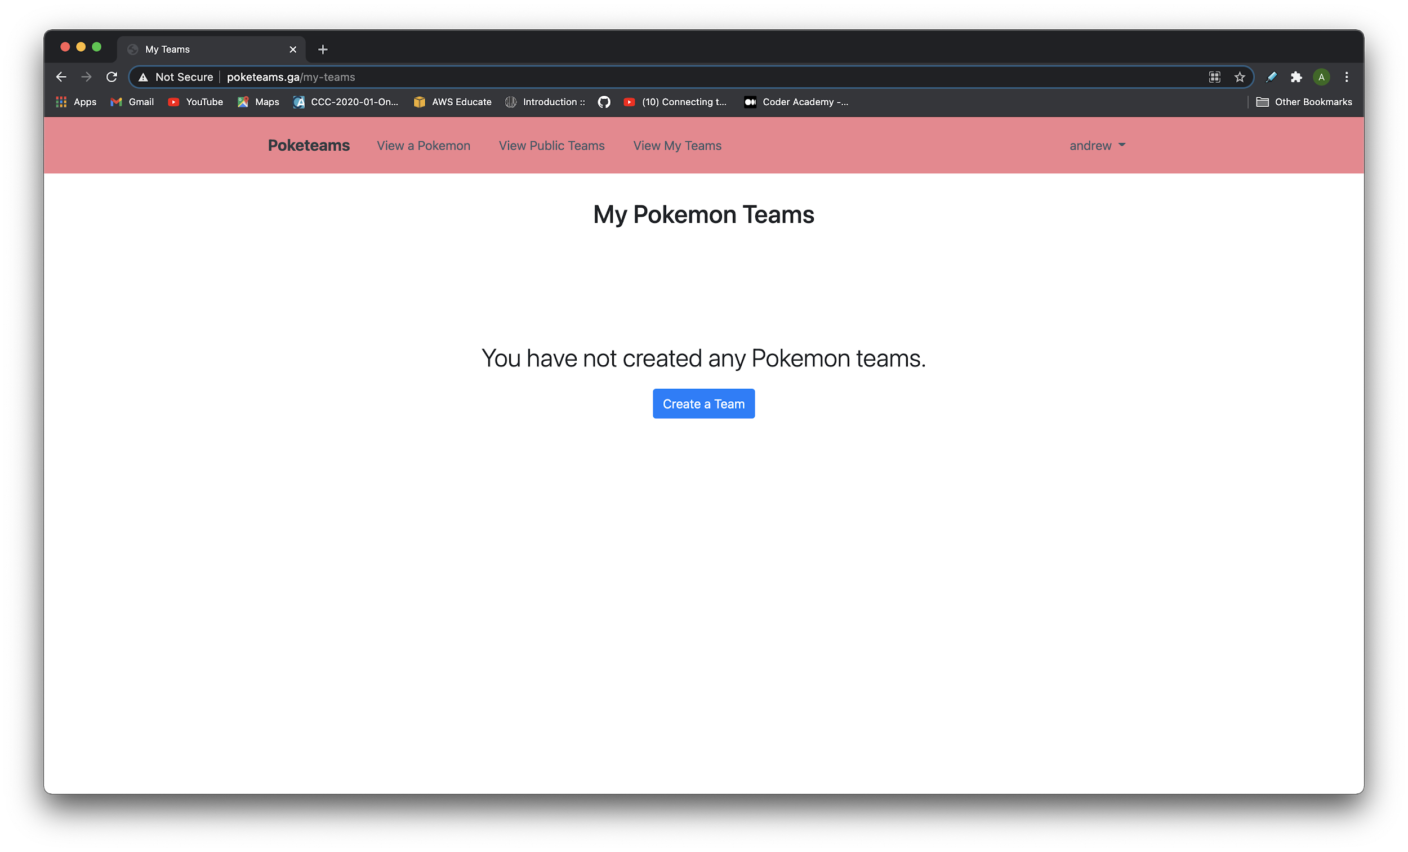
Application Demo
View my teams
|
Create a team

Slide 10
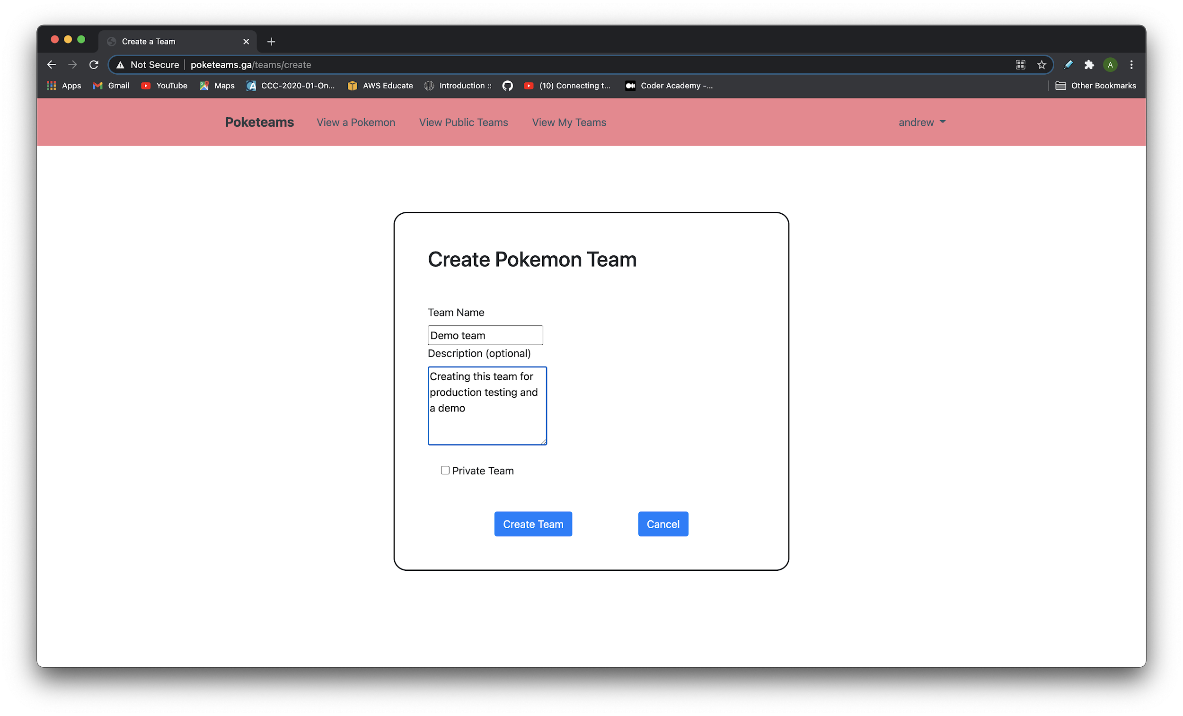
Application Demo
Creating a team

Slide 11
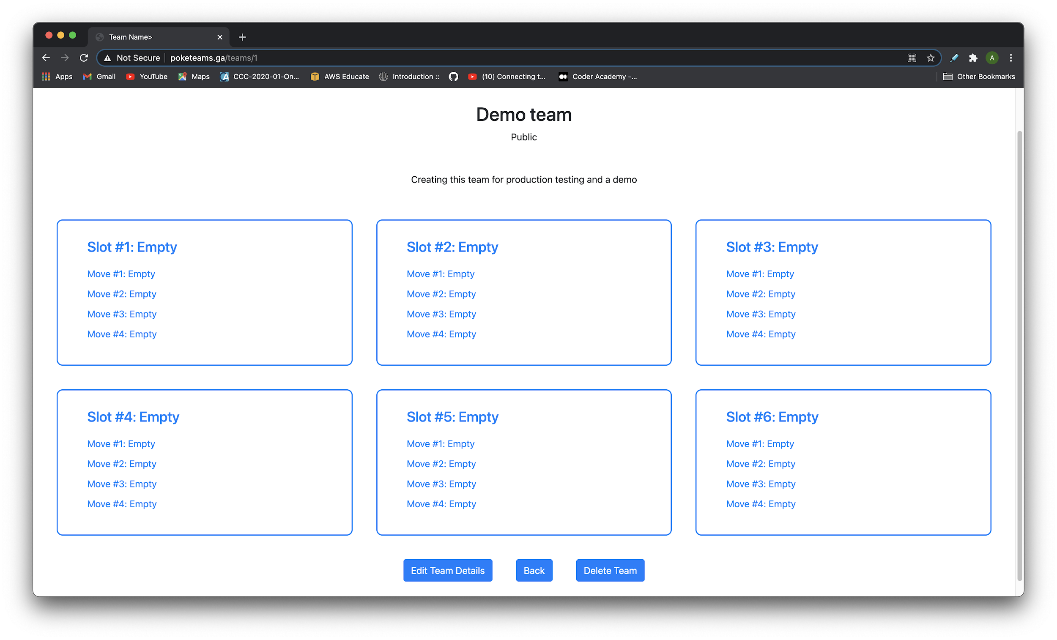
Application Demo
Empty team view
|
Select a slot

Slide 12
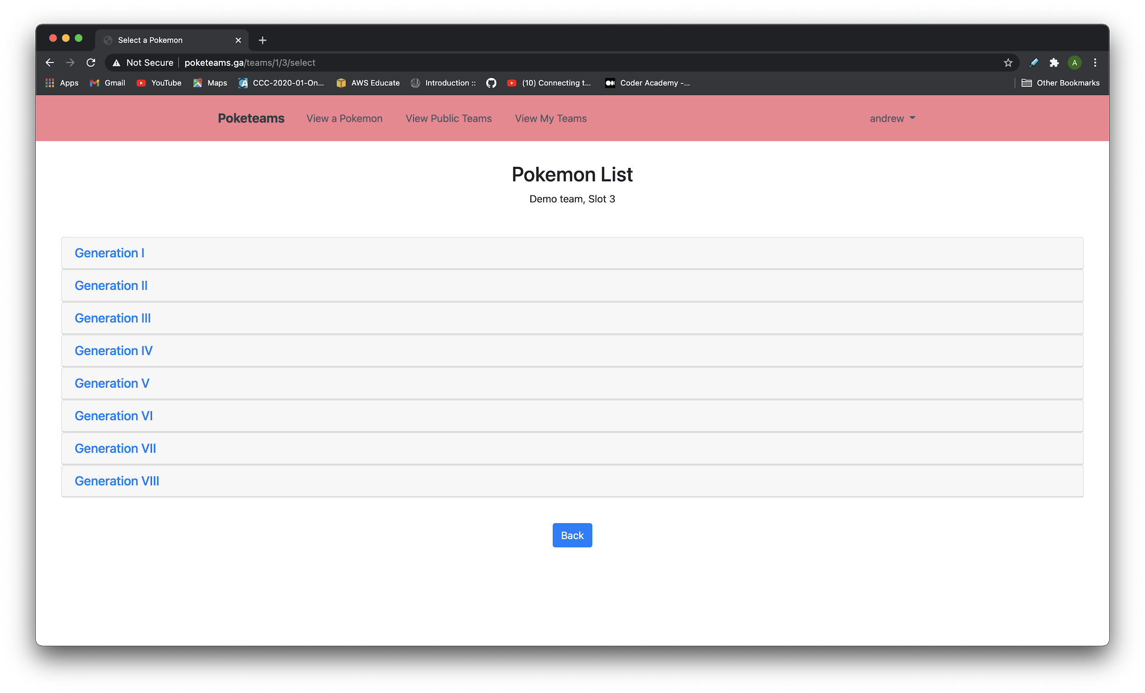
Application Demo
Select a pokemon

Slide 13
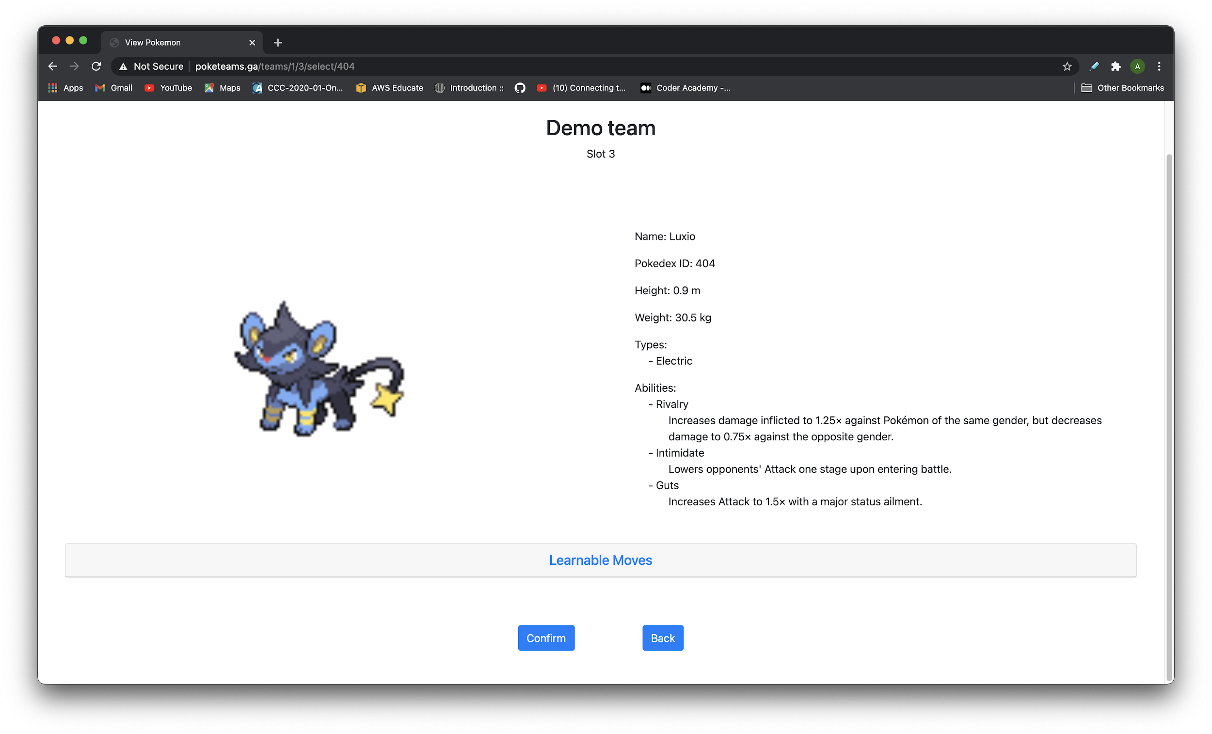
Application Demo
View pokemon to confirm adding to team

Slide 14
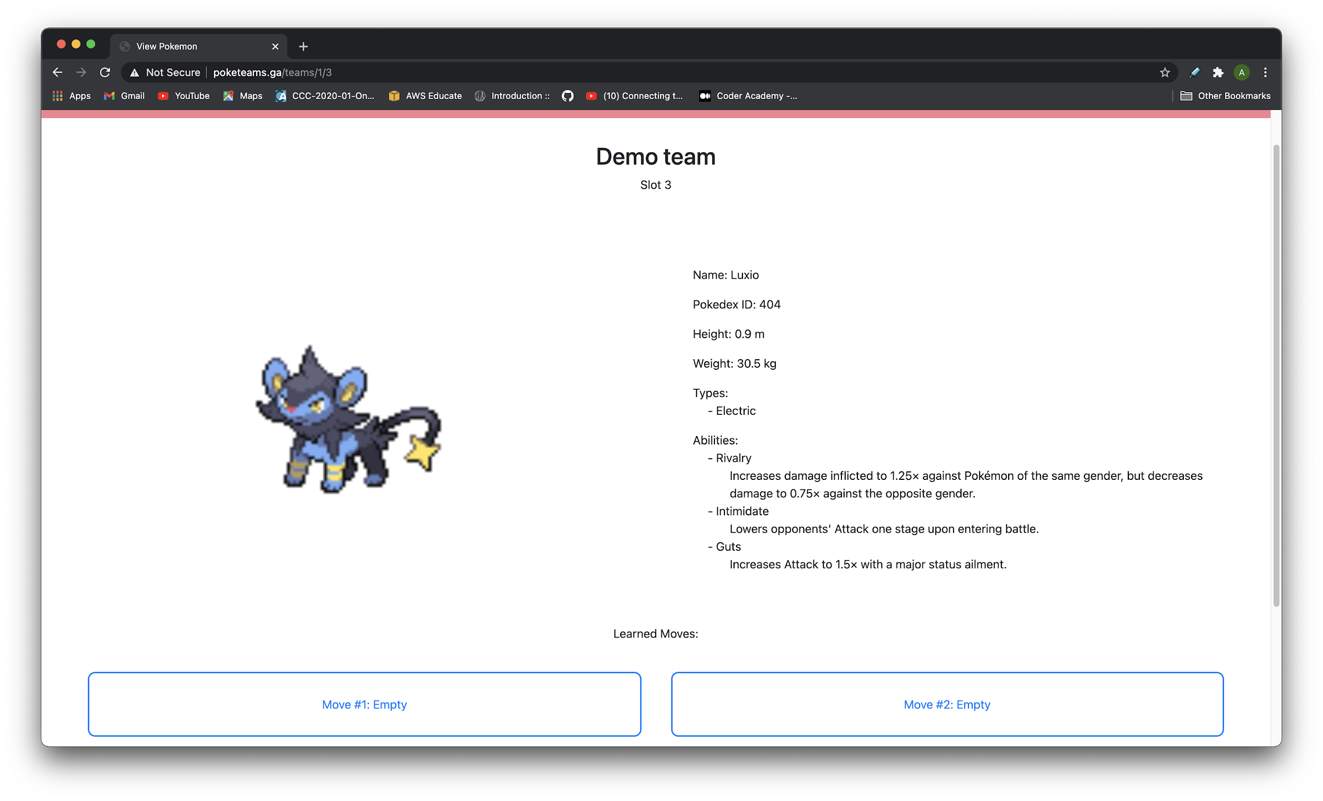
Application Demo
View of a pokemon as part of a team

Slide 15
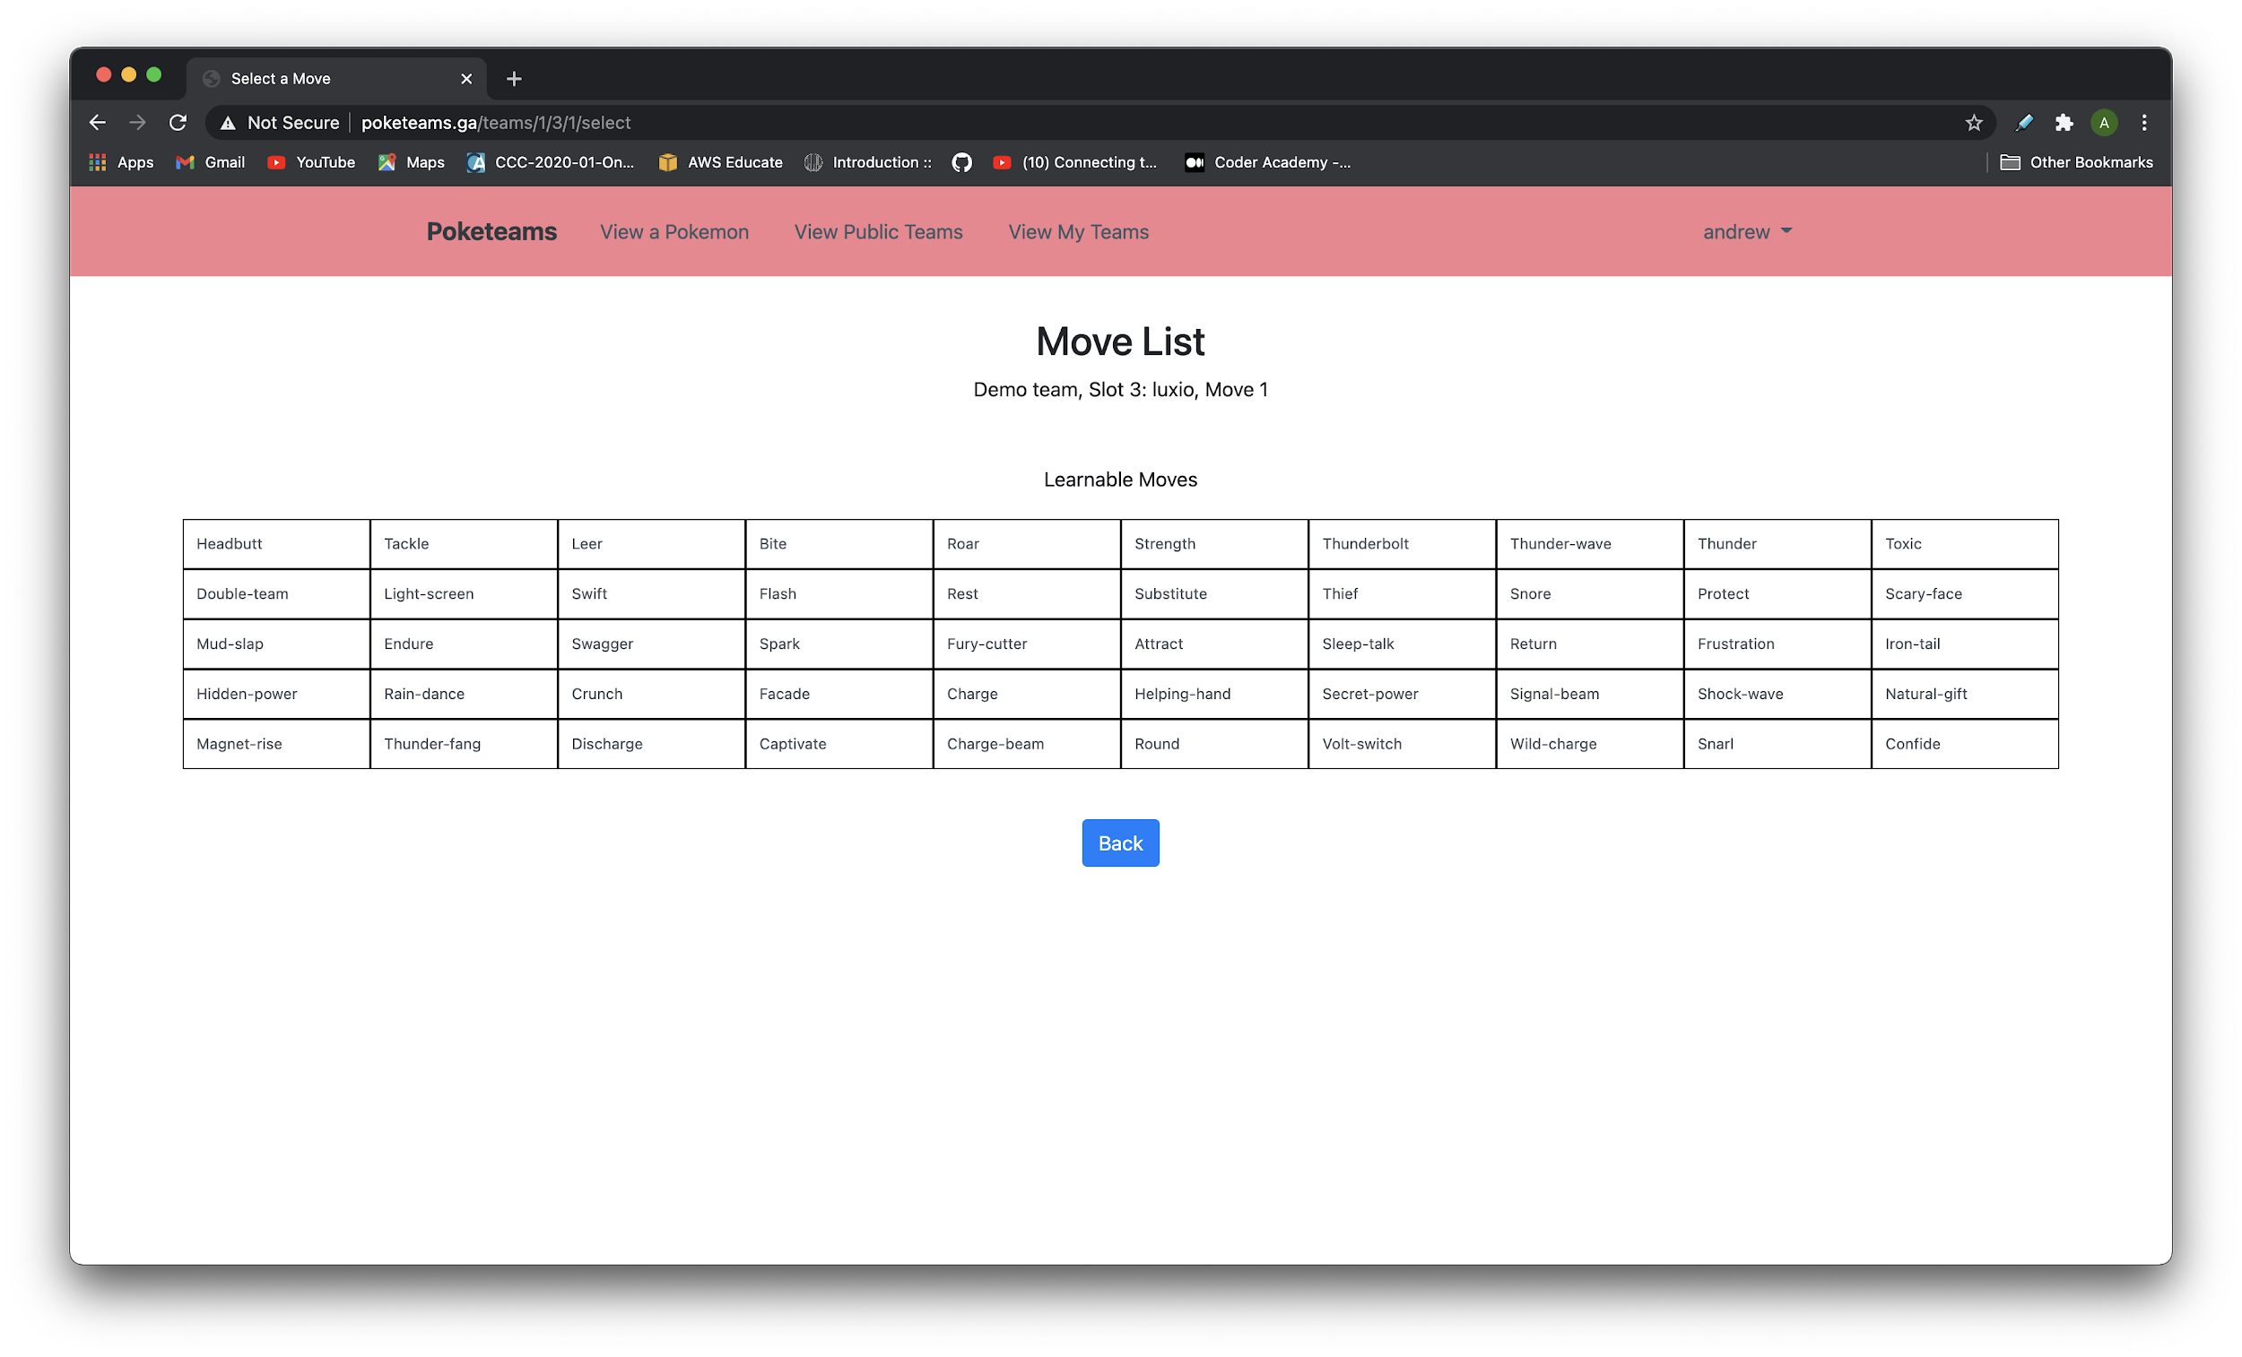
Application Demo
Select a move

Slide 16
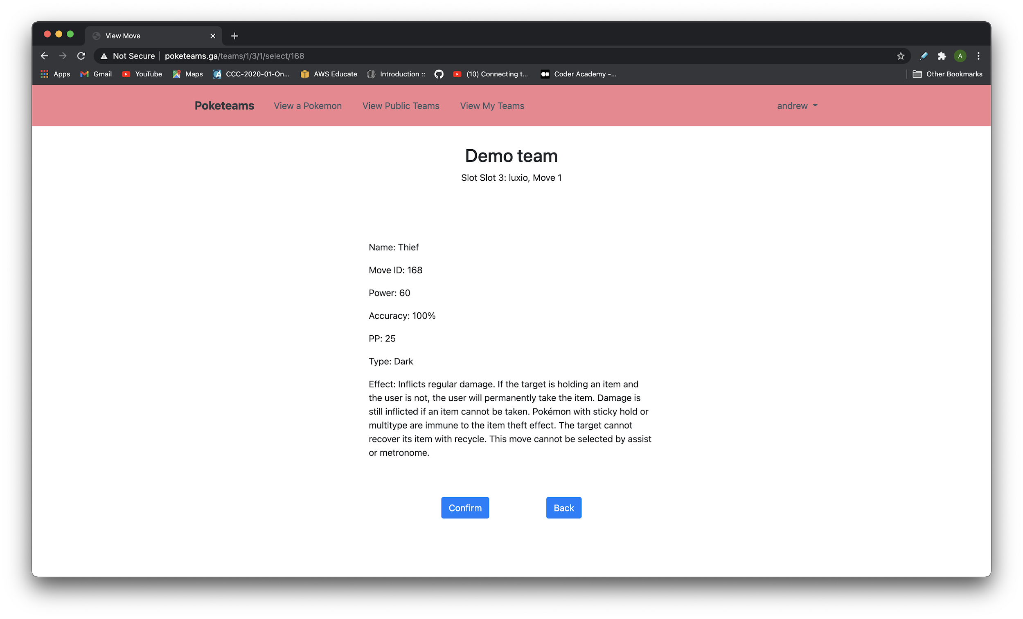
Application Demo
View the move to confirm adding it to the pokemon

Slide 17
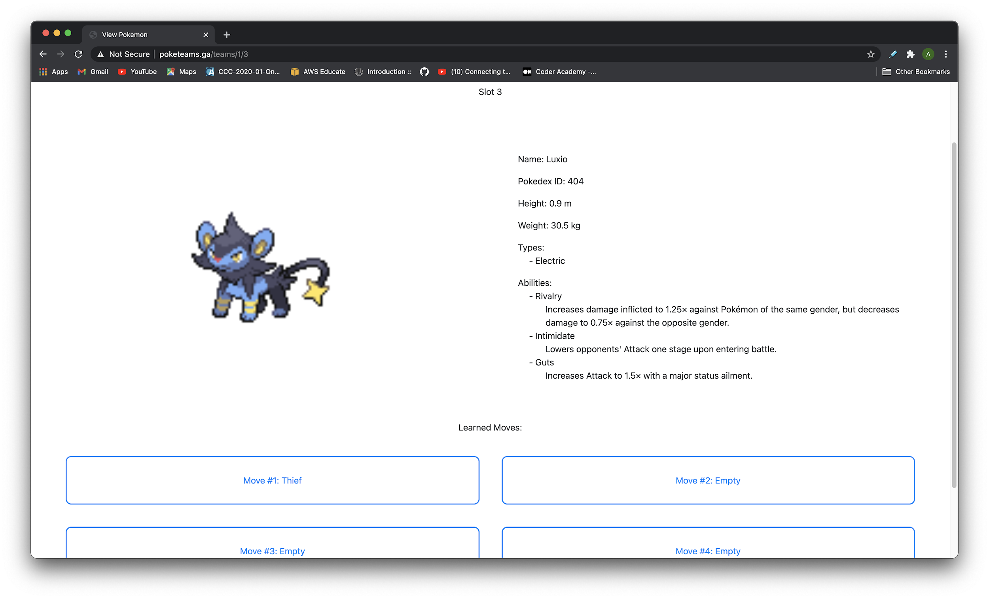
Application Demo
Pokemon view with the move assigned

Slide 18
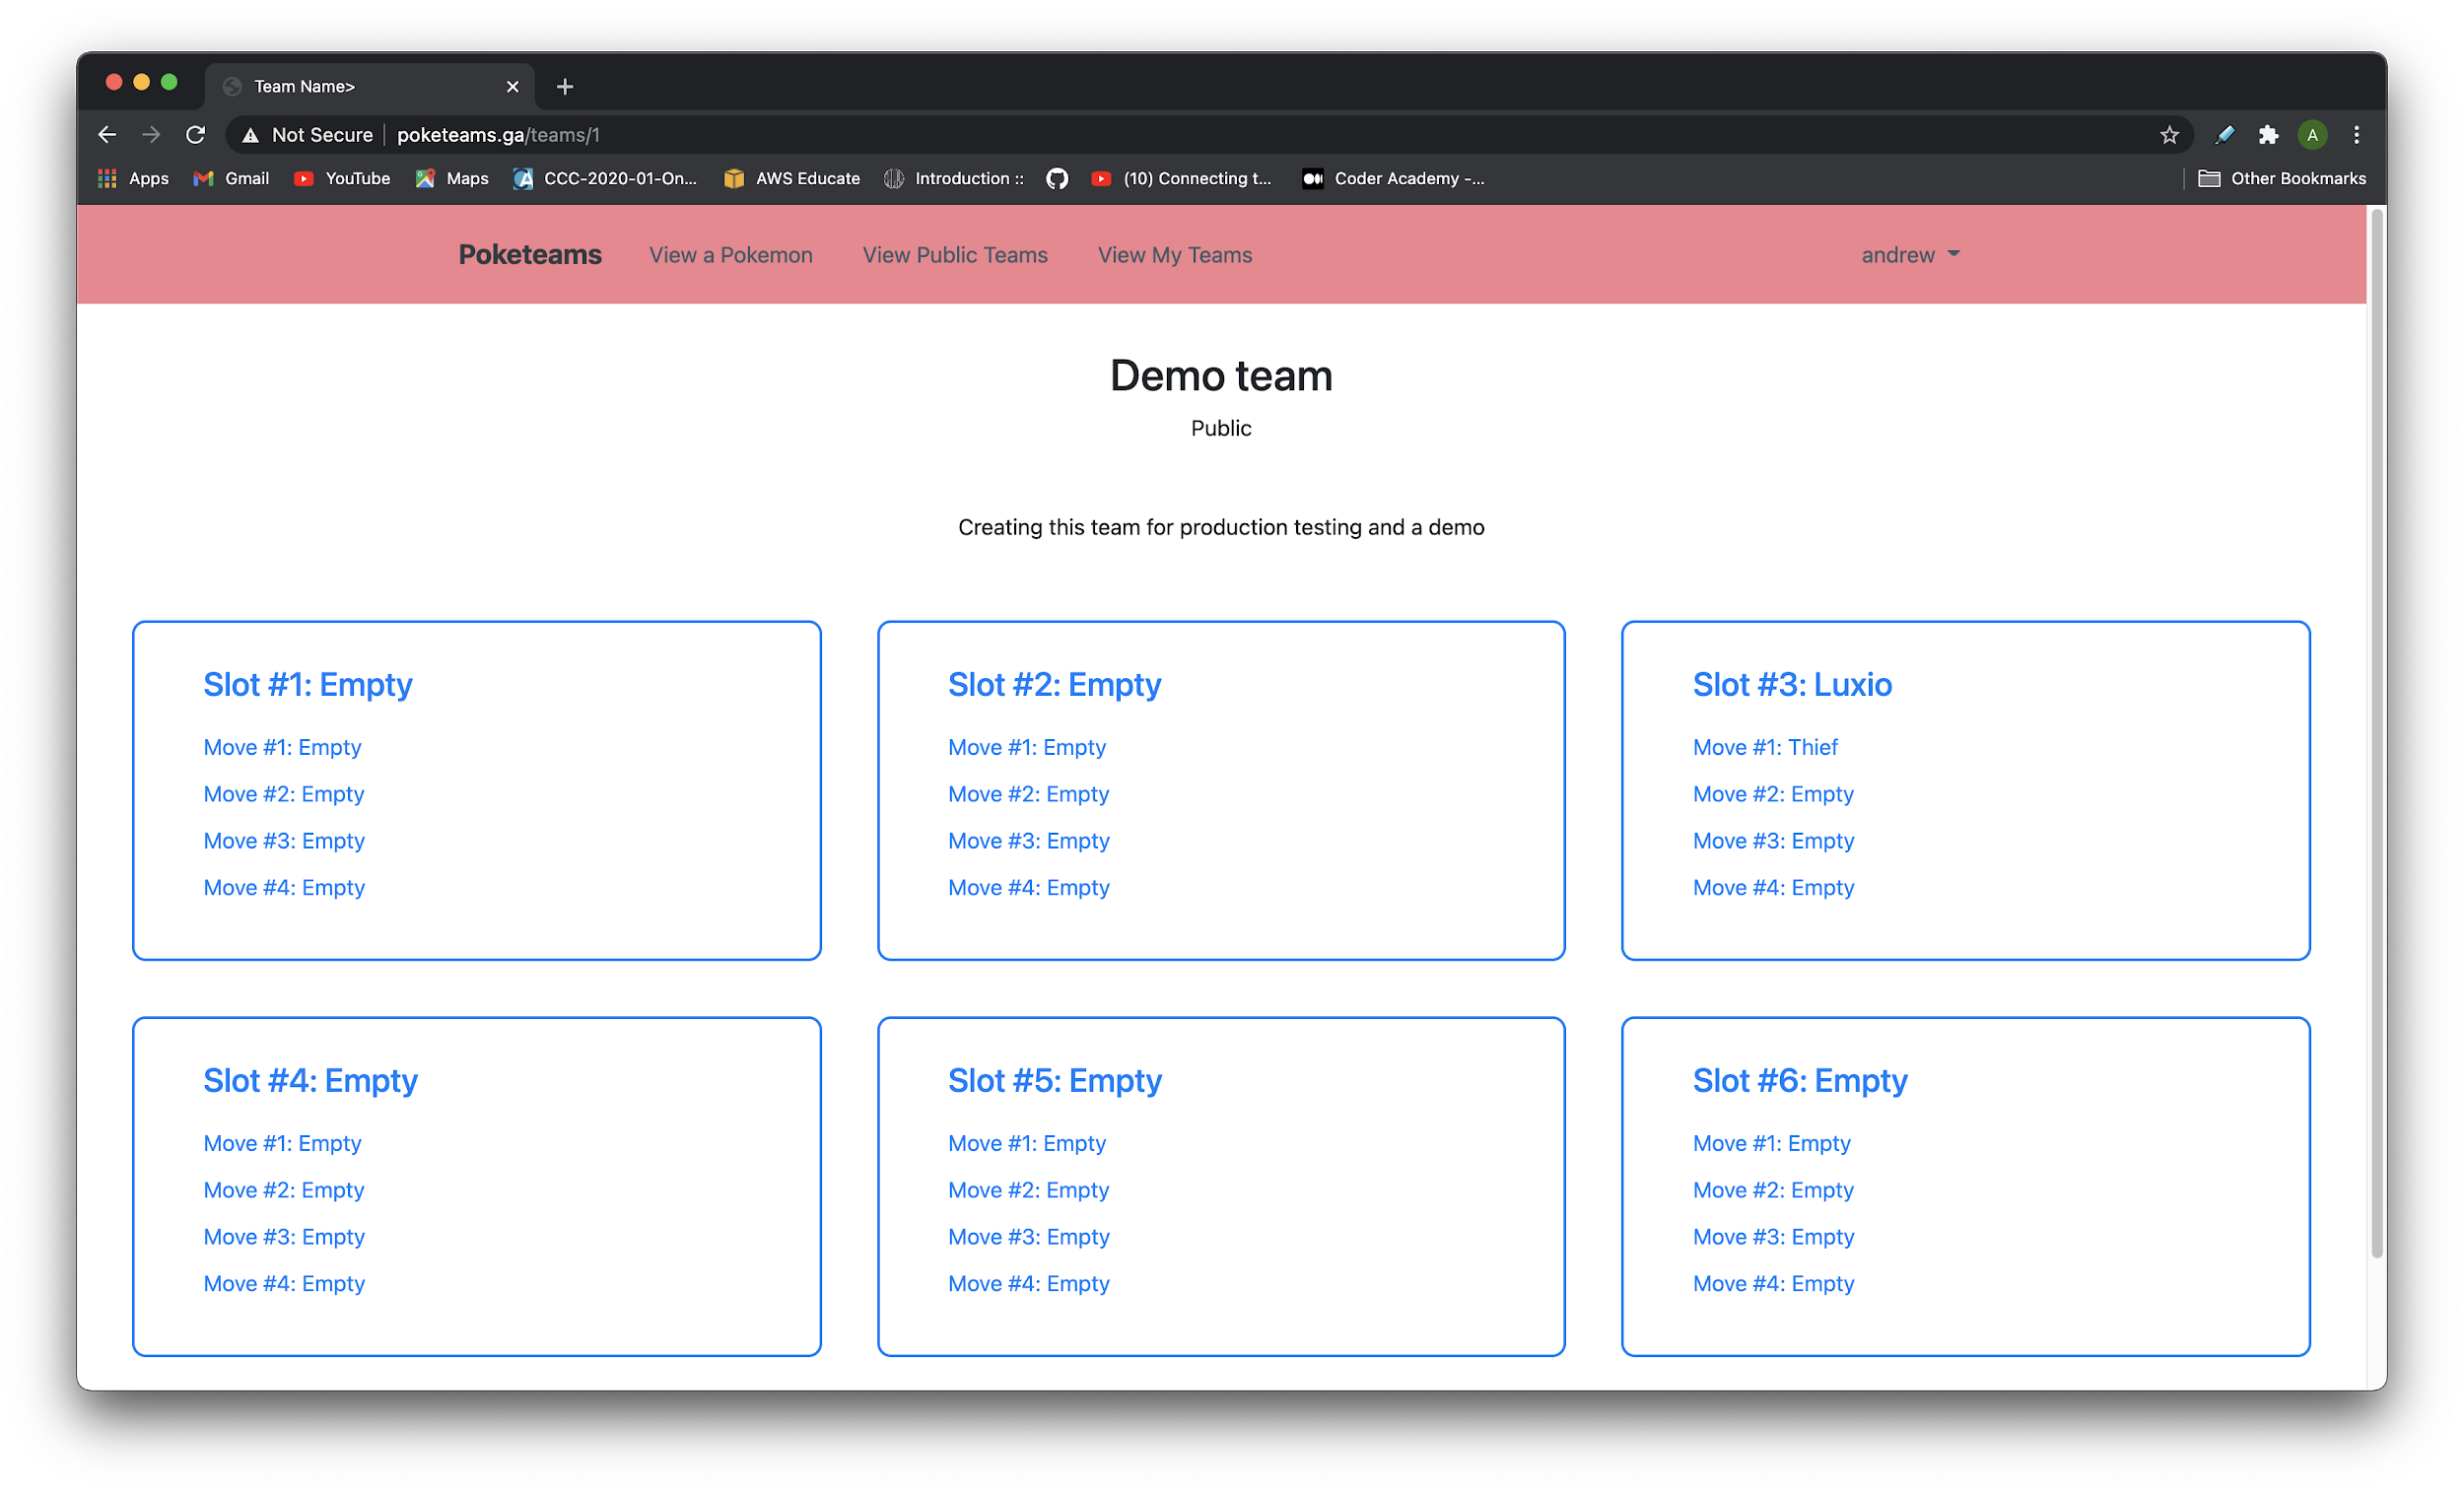
Application Demo
Team view showing the pokemon and move that were selected

Slide 19
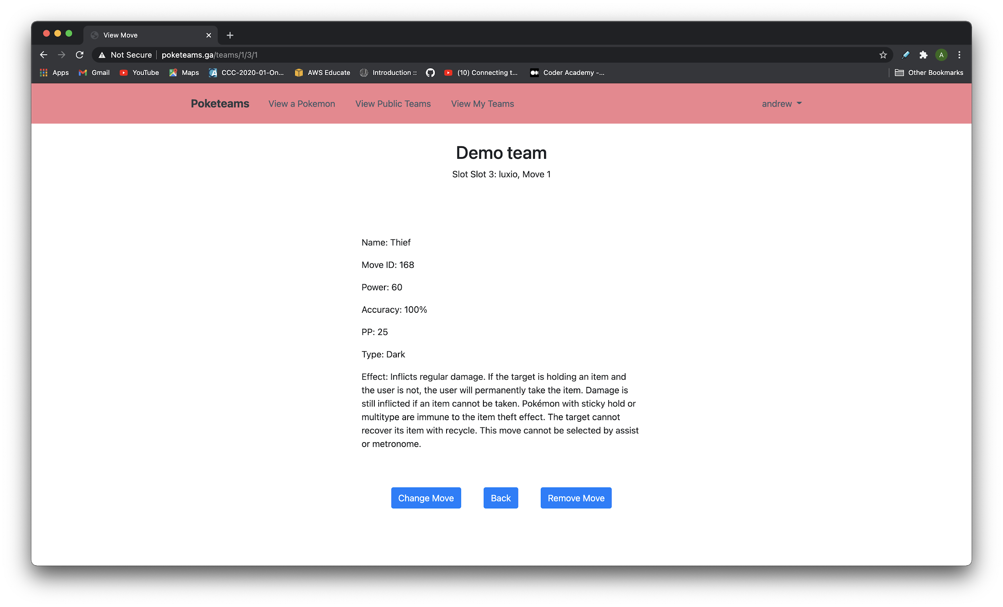
Application Demo
Changing the move

Slide 20

Application Demo
Move list again but now it has 1 move less because the pokemon has learnt a move

Slide 21
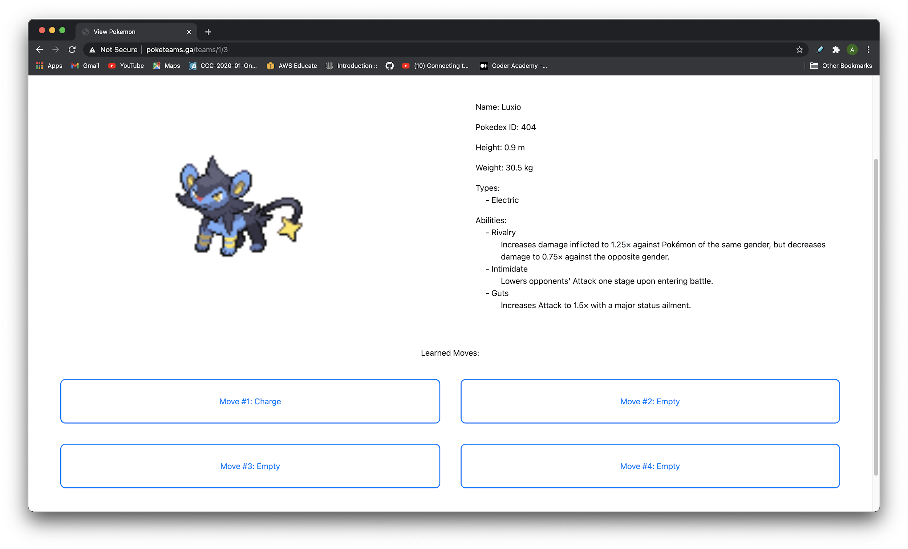
Application Demo
Move has now changed after selecting another move

Slide 22
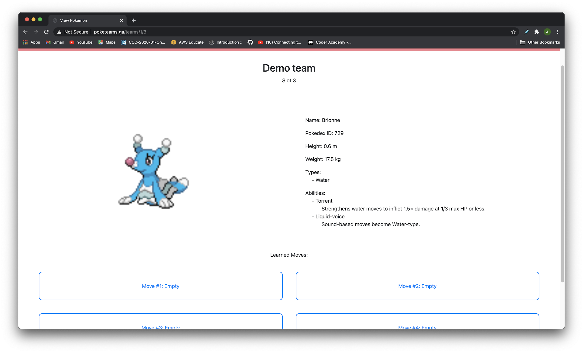
Application Demo
Changed the pokemon in the same slot and the move has been removed as well

Slide 23

Application Demo
So we can just assign another move

Slide 24
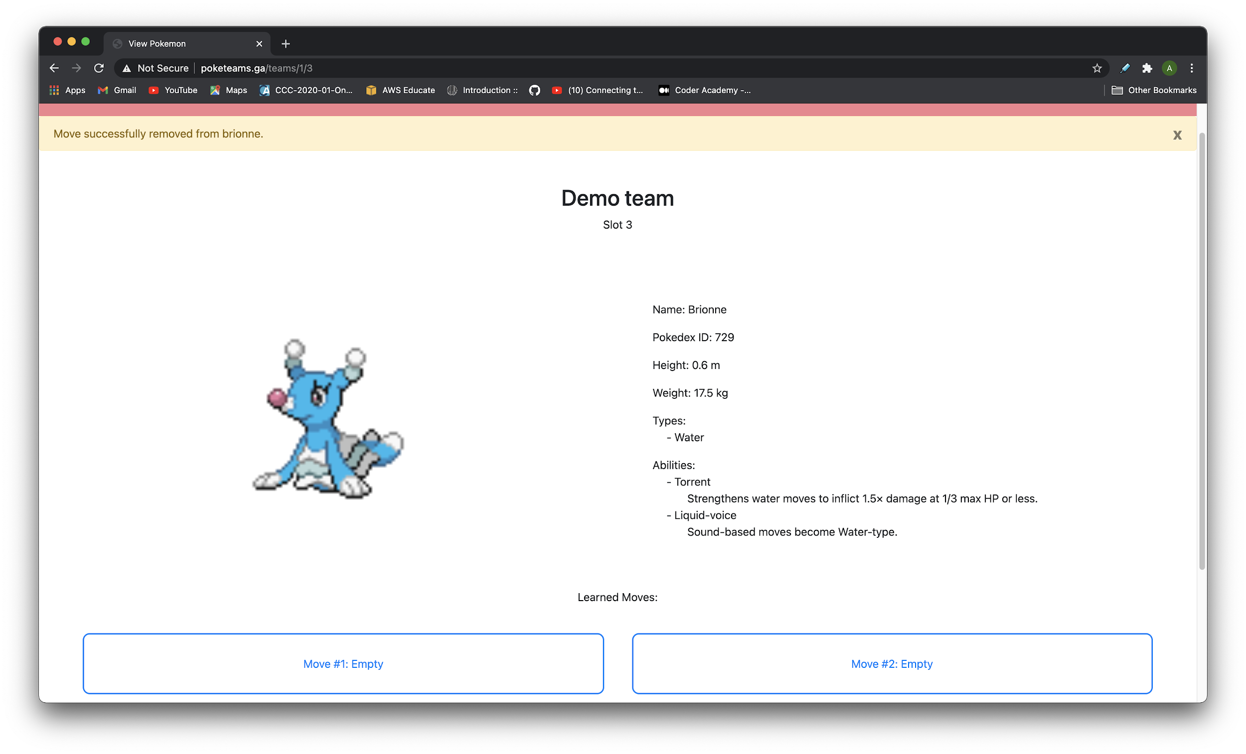
Application Demo
Used the remove move button to remove it without selecting another

Slide 25
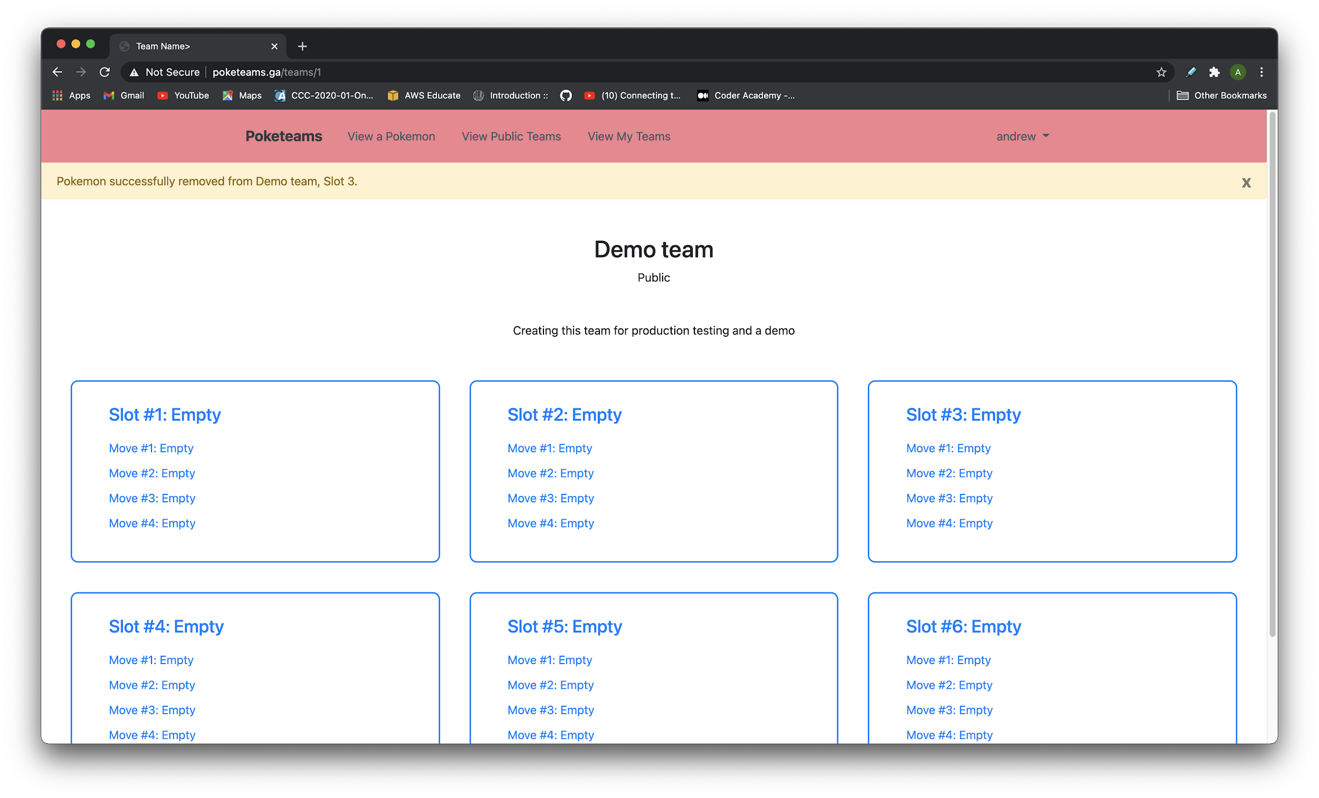
Application Demo
Removed the pokemon from the team using the remove pokemon button

Slide 26
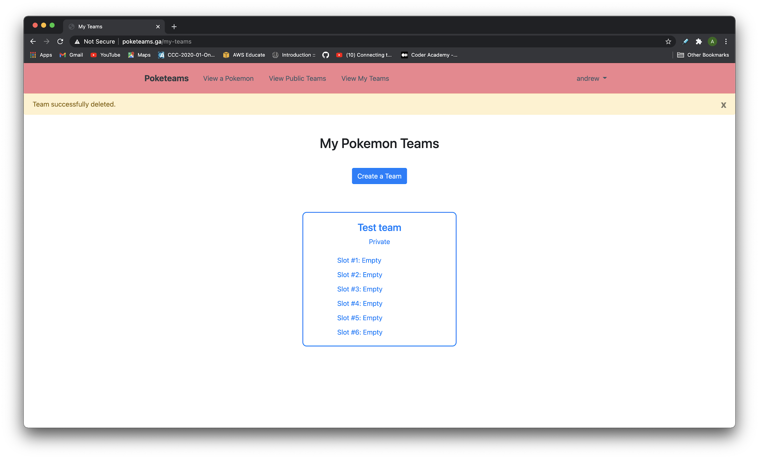
Application Demo
Created a private team then went back and deleted the public team we were using

Slide 27
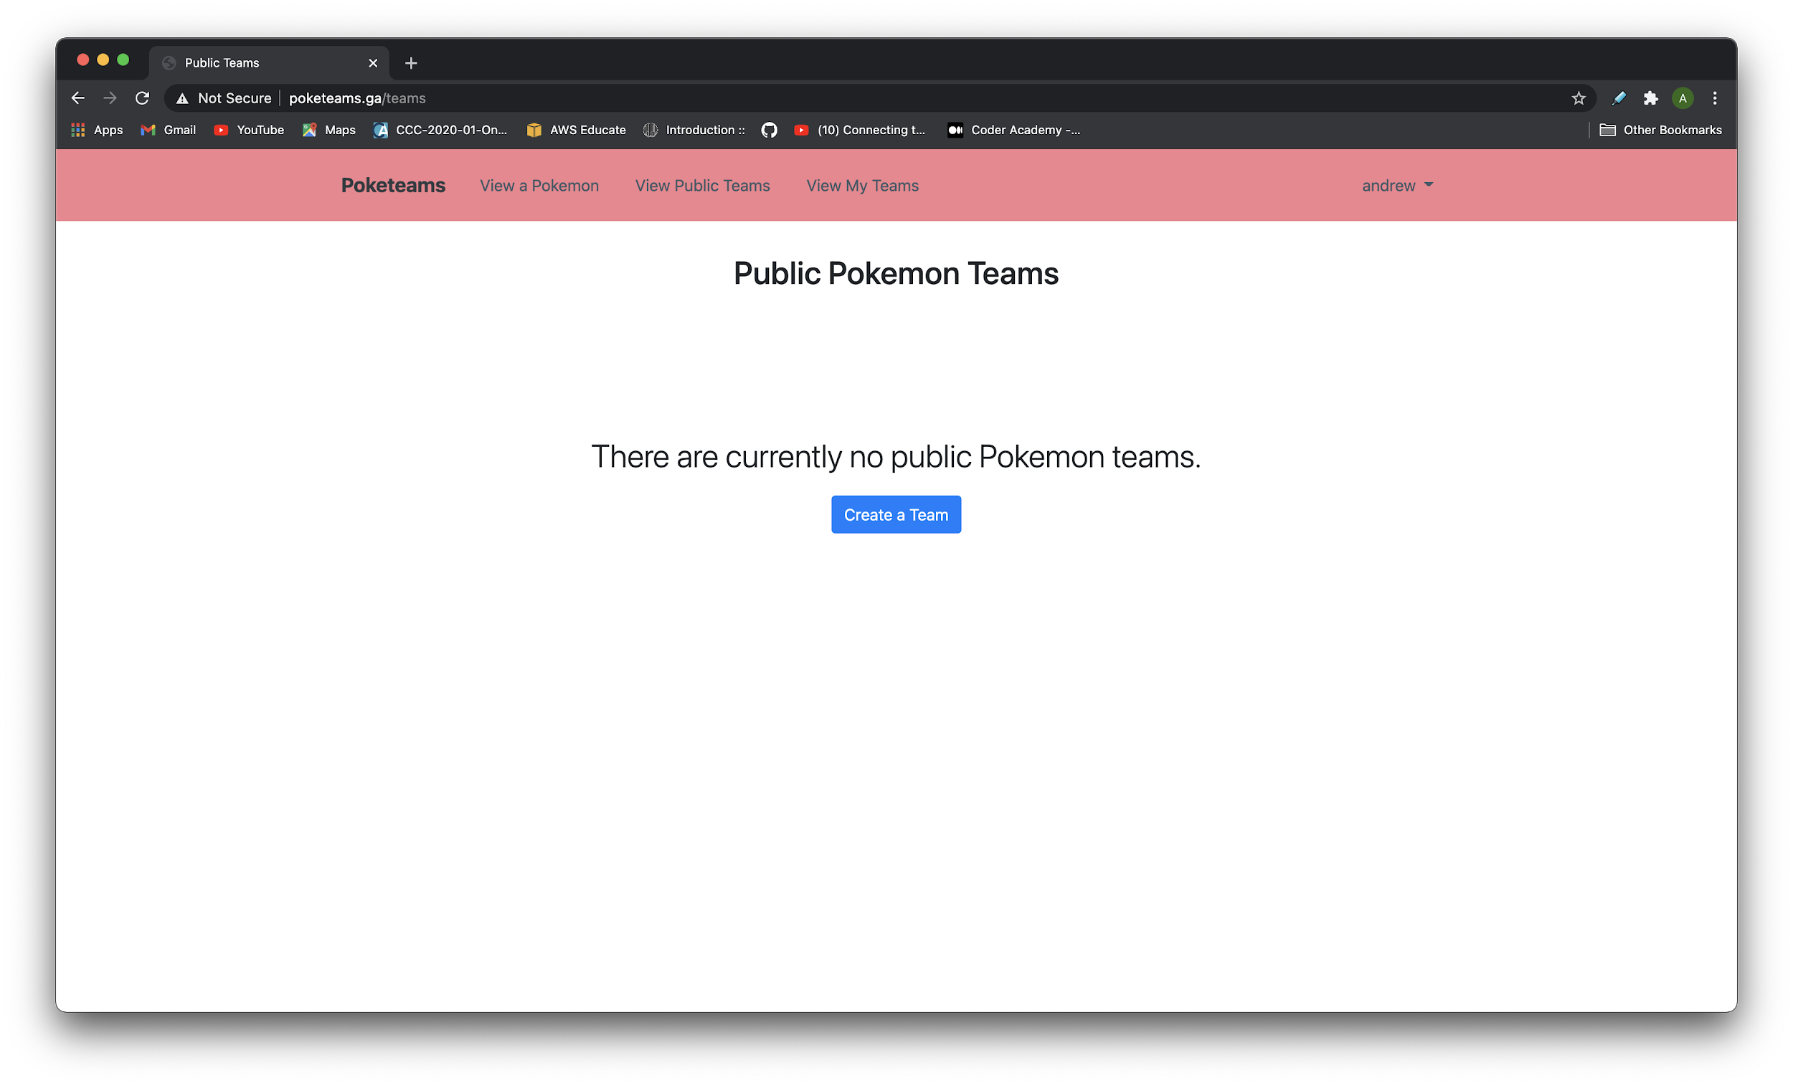
Application Demo
Going to the public teams list it’s empty as the new team we have is private

Slide 28
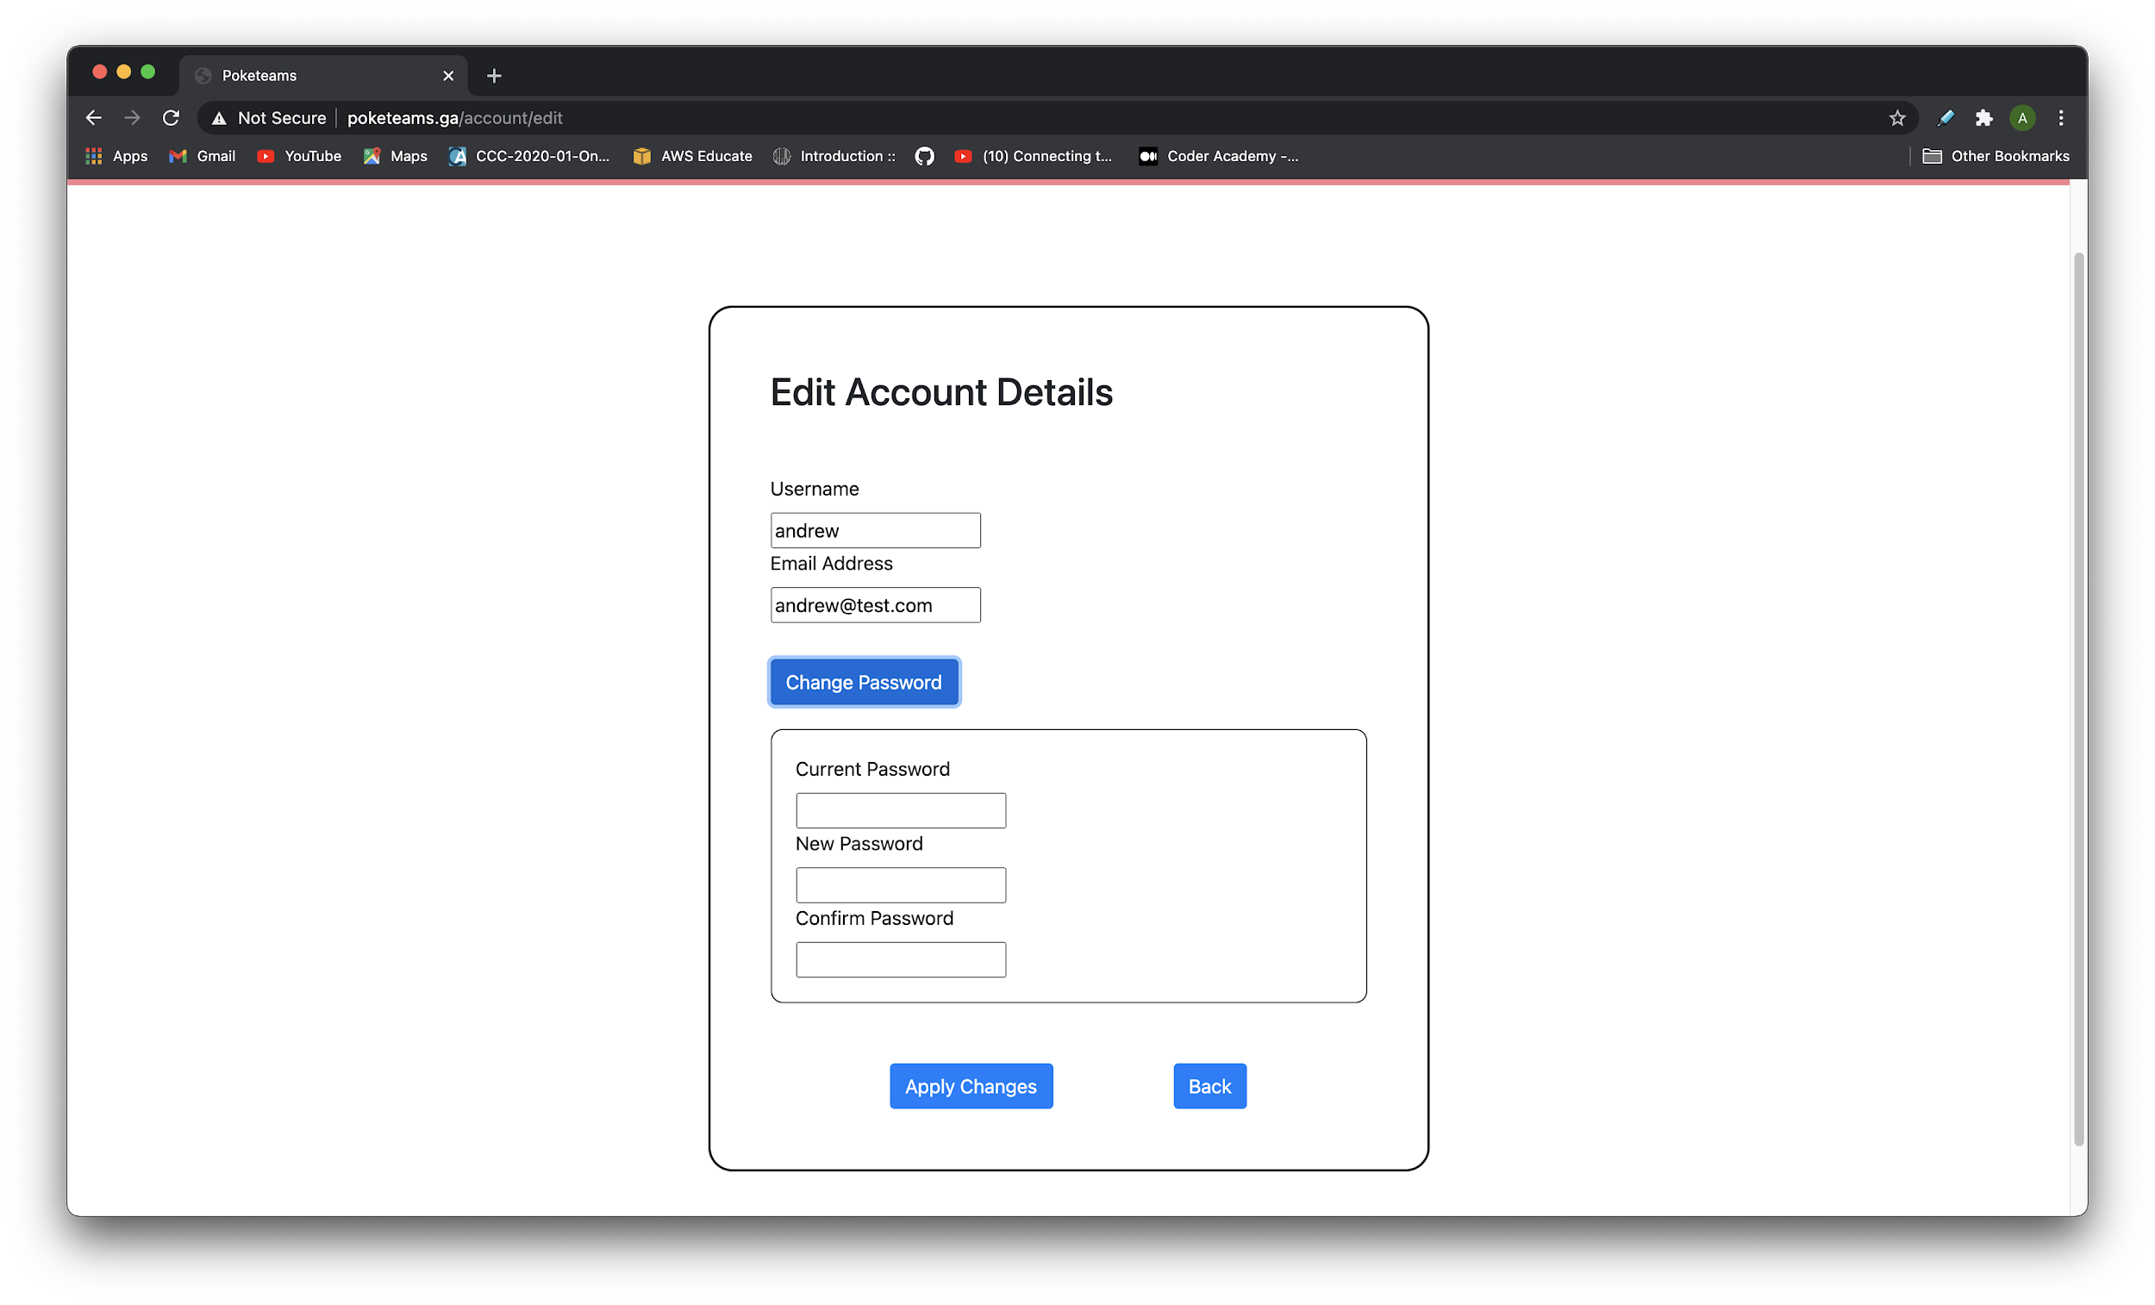
Application Demo
Edit account details page to allow for changing username, email or password

Slide 29
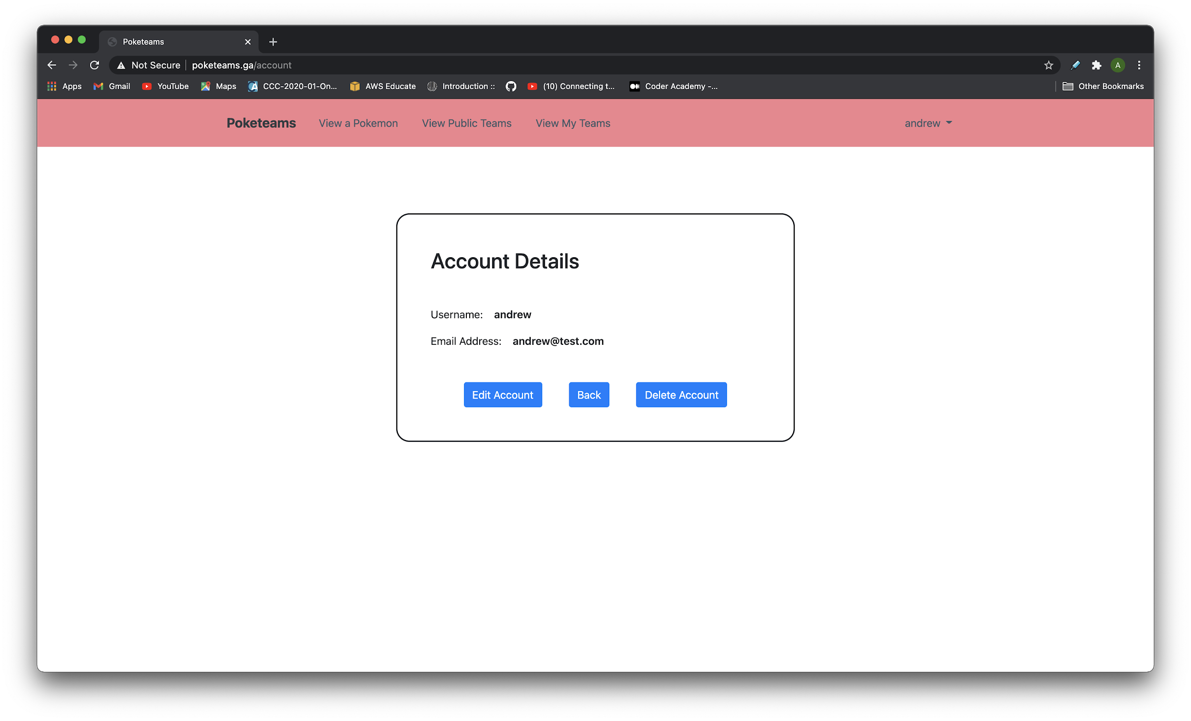
Application Demo
Somewhat bare account details page as users only have a username and email address at the moment

Slide 30
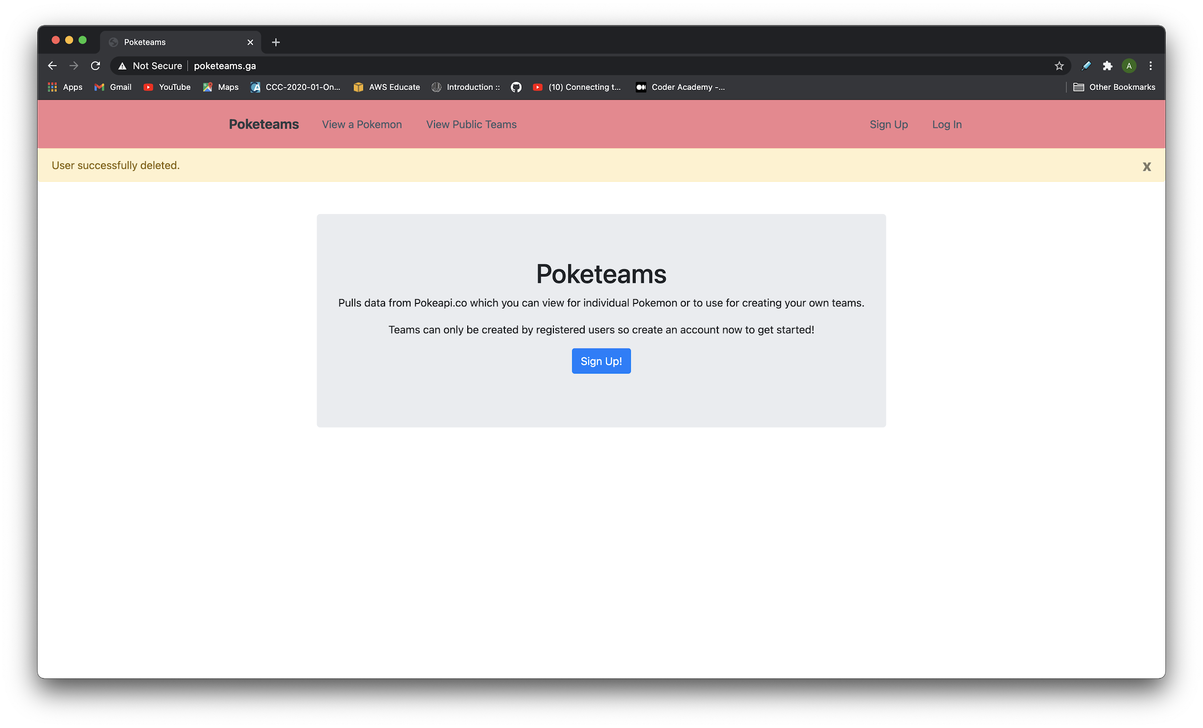
Application Demo
Deleting the user account to end the demo

Slide 31
Questions?

